Slide 1

Short Video Platform
(TikTok Clone – Design Patterns and Threads)
Department: CSE
Section: A3
Date: 3.2.2025

Slide 2
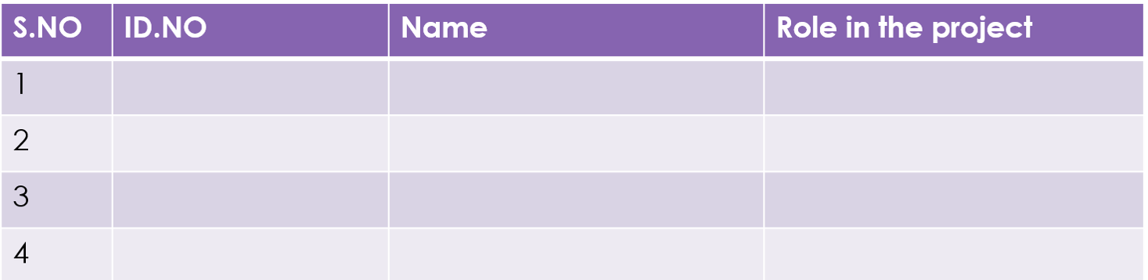
2310030044 Khushi
2310030046 S Nikhil
2310030041 S.Rajkumar
2310030001 Shayesta

Slide 3
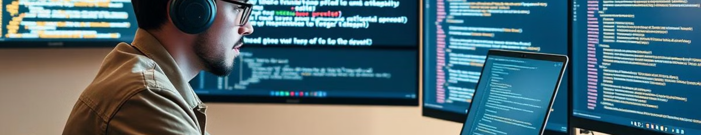
Frontend Development (Java-based)
User Interface
Video Player
Real-Time Interactions
The frontend, built using a Java-based framework, provides a user-friendly interface for video browsing, uploading, and interaction.
A customizable video player allows users to watch videos seamlessly with intuitive controls, playback options, and full-screen support.
Real-time interactions, including commenting, liking, and sharing, create an engaging user experience, fostering community engagement.
Notes:
3

Slide 4

Backend Development (Core Java)
1
User Authentication and Authorization
2
Video Database Management
Secure user authentication and authorization are implemented to protect user data and prevent unauthorized access.
The backend manages a video database, storing video metadata, user information, and interaction data efficiently.
3
Video Transcoding and Storage
4
API for Frontend Communication
The backend transcodes videos to different formats for optimal playback across various devices. Secure video storage and retrieval are ensured.
A robust API provides a communication bridge between the frontend and backend, allowing for data exchange and functionality requests.
Notes:
4

Slide 5




Threads for Concurrency
Video Processing
Notification Delivery
Threads significantly enhance video processing speeds by allowing multiple videos to be processed concurrently, optimizing performance.
Threads improve notification delivery by handling multiple notifications simultaneously, ensuring timely updates to users.
Real-Time Updates
Threads enable real-time updates for features like comments, likes, and shares, providing a responsive and interactive user experience.
Notes:
5

Slide 6

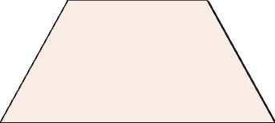
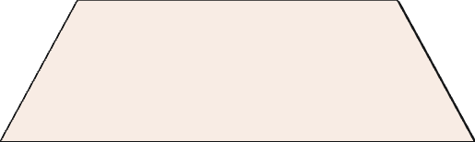
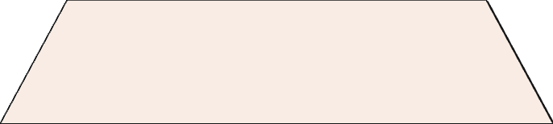
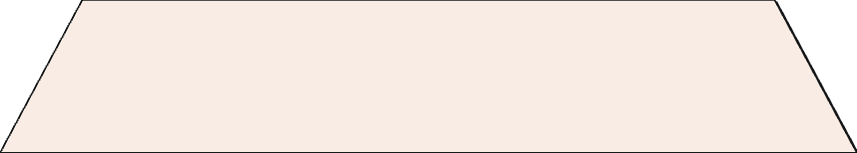
Key Features and Design Patterns
1
Core Functionality
2
User Management
Singleton Pattern
3
Video Processing
Strategy Pattern, Threading
4
Notifications
Observer Pattern
5
Recommendations
Strategy Pattern, Decorator Pattern
Notes:
10

Slide 7
Design Patterns
Singleton
Strategy
Ensures a single instance for managing shared services, such as AuthService for authentication and VideoService for video management.
Implements flexible video processing algorithms for tasks like basic or advanced processing, providing a scalable approach.
Observer
Factory
Enables real-time notifications for user actions, such as updates when a new video is uploaded or liked.
Dynamically creates essential objects like users, videos, or processing strategies, simplifying extensibility.
Notes:
9

Slide 8
Project Structure
1
Backend
2
Core Logic
User Management, Video Processing, Notifications
3
Database
Video Metadata, User Information, Interactions
4
API
Communication with Frontend
Notes:
11

Slide 9
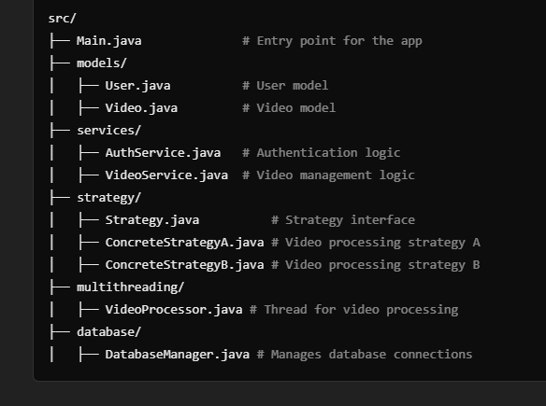
Best Practices for Implementation
1
2
Design First
Modular Architecture
Clearly define the platform's features and functionalities. Create a detailed design, considering user needs, performance, and scalability.
Design the platform with modular components for easier maintenance, debugging, and future enhancements.
3
4
Code Quality
Security
Maintain clean, well-documented code for improved readability, collaboration, and future development.
Implement robust security measures to protect user data and prevent unauthorized access. Employ best practices for authentication and authorization.
Notes:
13

Slide 10
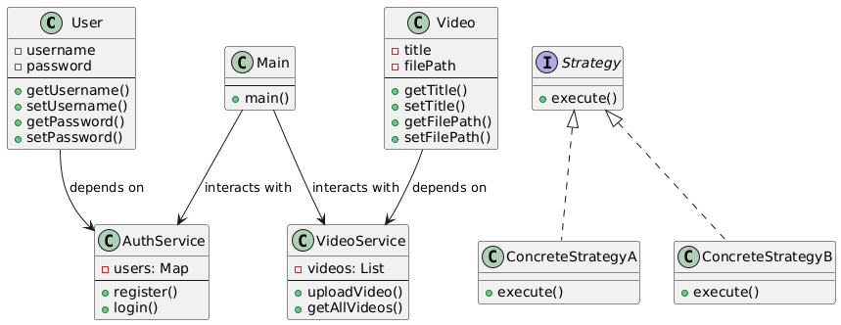
Classes:
User:
Attributes:
username (private)
password (private)
Methods:
getUsername() - Retrieves the username.
setUsername() - Sets the username.
getPassword() - Retrieves the password.
setPassword() - Sets the password.
Relationship: Depends on AuthService.
AuthService:
Attributes:
users: Map - A collection of users
(probably mapping usernames to passwords or user objects).
Methods:
register() - Registers a new user.
login() - Authenticates a user.
Main:
Methods:
main() - Acts as the entry point of the application.
Relationships:
Interacts with AuthService for user authentication.
Interacts with VideoService for managing videos.
Notes:
14

Slide 11
Video:
Attributes:
title (private) - The title of the video.
filePath (private) - The file path of the video.
Methods:
getTitle() - Retrieves the video's title.
setTitle() - Sets the video's title.
getFilePath() - Retrieves the video's file path.
setFilePath() - Sets the video's file path.
VideoService:
Attributes:
videos: List - A collection of uploaded videos.
Methods:
uploadVideo() - Uploads a new video.
getAllVideos() - Retrieves all uploaded videos.
Relationship: Depends on Video.
Interfaces and Implementations:
Strategy (Interface):
Method:execute() - Defines a strategy operation.
ConcreteStrategyA:
Implements the Strategy interface.
Provides a specific implementation for the execute() method.
Notes:
14

Slide 12
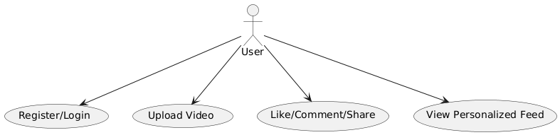
Use Case Diagram
The Diagram visually represents system functionalities by showing interactions between users (actors) and system features (use cases). It helps in understanding user requirements and system behavior at a high level.
Actors: External entities interacting with the system.
Primary Actors: Users of the system (e.g., Registered User, Guest User).
Secondary Actors: External systems or services interacting with the platform (e.g., Payment Gateway, Notification Service).
Use Cases:Represent the functional requirements or tasks performed by the system (e.g., Upload Video, View Feed, Like Video
Association: Links between actors and use cases (e.g., User interacts with Upload Video).
Include: Represents a mandatory sub-use case (e.g., Authenticate is included in Login).
Extend: Represents optional behavior (e.g., Share Video extends View Video).
Notes:
14

Slide 13
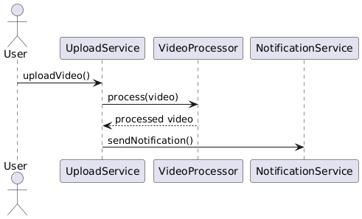
Interaction Diagram
Interaction diagrams show how objects in the system interact with each other. These diagrams emphasize the dynamic behavior of the system during specific scenarios. They are particularly useful for illustrating how use cases are realized in the system's architecture.
There are three main types of interaction diagrams:
Sequence Diagram - Focuses on the time-ordered interaction between objects.
Collaboration Diagram (Communication Diagram) - Focuses on object relationships and message flow.
3.Timing Diagram - Focuses on object state changes over time.
For a Short Video Platform (TikTok Clone), interaction diagrams can be used to represent scenarios like uploading a video, viewing a feed, liking/commenting on a video, etc.
Notes:
14

Slide 14
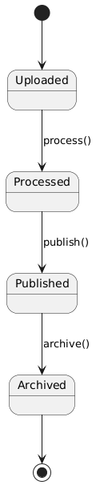
State Chart Diagram
A State Chart Diagram shows how an object changes states in response to events or actions. Each state represents a condition, and transitions indicate movement between states. It’s useful for understanding the behavior of dynamic systems, like a video moving from "Uploading" to "Published" or "Failed.“
Uploaded: The video has been successfully uploaded to the platform and is awaiting processing.
Processed: The video has been transcoded or analyzed and is ready for publishing.
Published: The video is live and available for users to view on the platform.
Archived: The video is no longer active but is stored for record-keeping or future reference.
Notes:
14

Slide 15
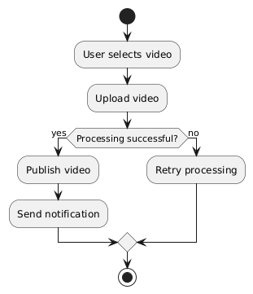
Activity Diagram
An Activity Diagram shows the step-by-step workflow of a process or system. It highlights the sequence of actions, decisions, and parallel flows, making it useful for visualizing tasks like video uploads or user interactions. This diagram helps in understanding process flow and identifying
User selects a video file: The user chooses a video file from their device to upload to the platform.
Video is uploaded: The selected video file is transferred to the platform's server for further processing.
Processing is done: The platform processes the uploaded video, such as encoding or resizing, to make it ready for publishing
Notification is sent: The platform notifies the user that the video has been successfully processed and is ready.
Notes:
14

Slide 16
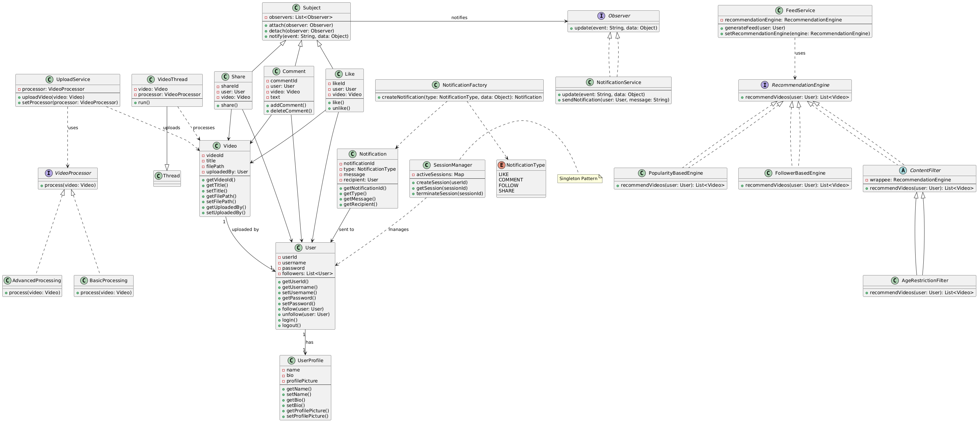
Notes:
14

Slide 17
Design Patterns and Threads Explained
Pattern
Purpose
Classes Involved
Singleton
Ensures only one instance
SessionManager
Factory
Creates notifications dynamically
NotificationFactory, Notification
Observer
Notifies users about likes, comments, shares
NotificationService, Like, Comment, Share, Subject
Strategy
Provides different recommendation strategies
RecommendationEngine, PopularityBasedEngine, FollowerBasedEngine
Decorator
Adds filters to recommendations
ContentFilter, AgeRestrictionFilter
Threading
Processes videos asynchronously
VideoThread
Notes:
16

